Slide 1
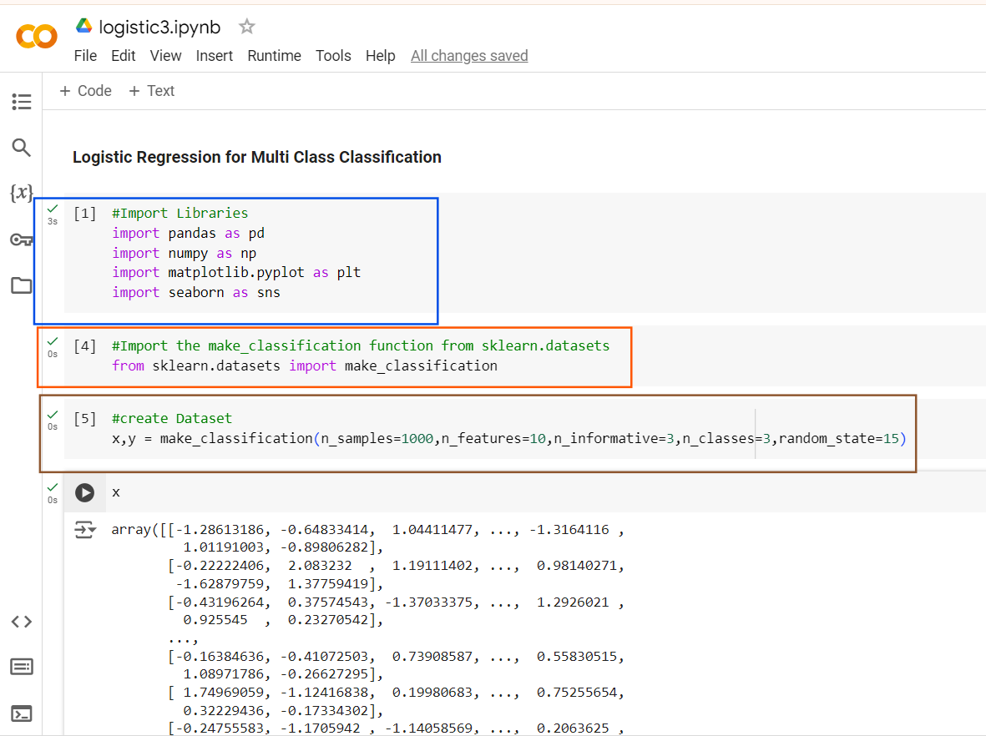
n_informative=3: Out of the 10 features, 3 will be informative, meaning these 3 features will have a direct impact on the classification task.

Slide 2
If you don't control n_informative, all features might be useful, which isn't realistic in most data science problems.
In practice, we deal with irrelevant or noisy features that don't help with classification.
By defining n_informative, you create noise in the dataset, helping to evaluate how well models perform under more challenging, noisy conditions.

Slide 3
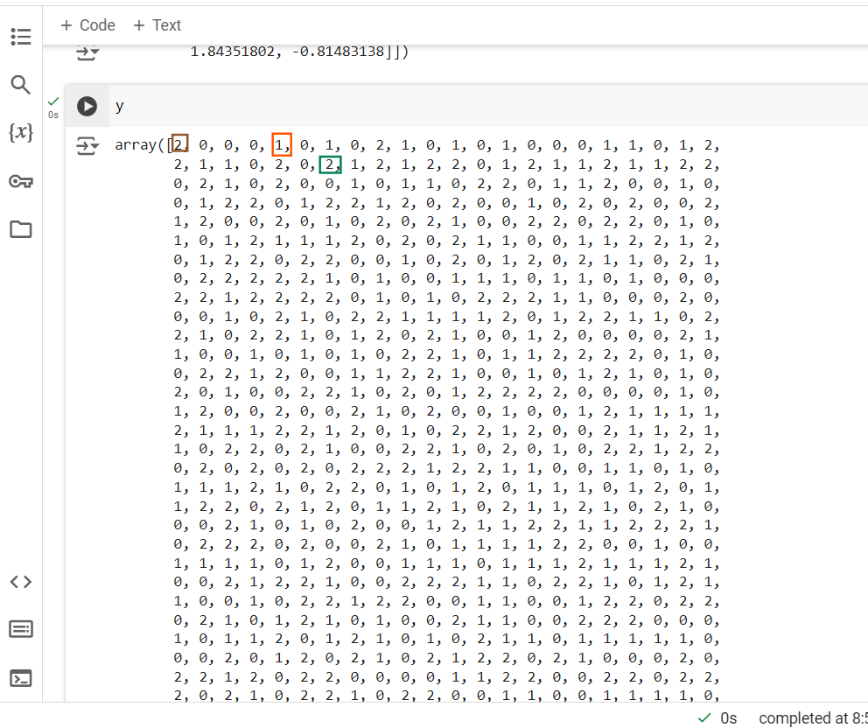
You can see 0,1,2
Since we specified 3 classes

Slide 4
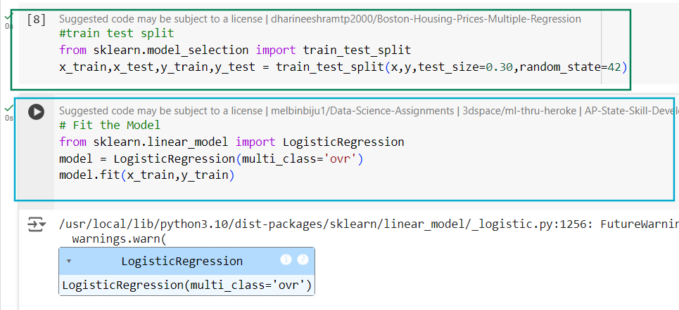
This setting tells the model to apply the one-vs-rest strategy

Slide 5
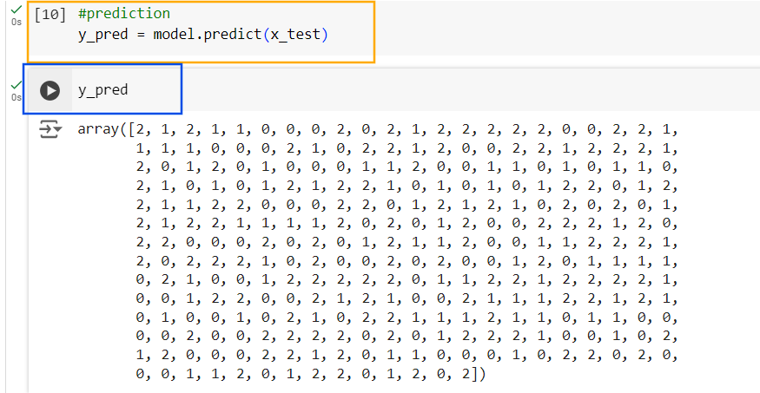

Slide 6
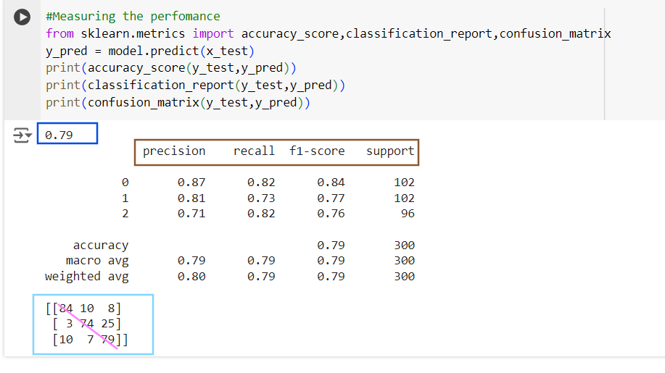
All the diagonal elements are correct

